Slide 1

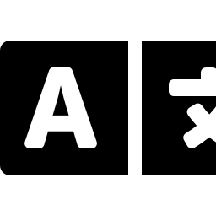

B.TECH FINAL YEAR MAJOR PROJECT
Semantic Prompt-Guided Human Action Recognition using Vision-Language Fusion
STUDENT
Varunbhai Kalotra | Roll No. 24CE048
PROJECT GUIDE
Dr. Mrugendrasinh Rahevar, Assistant Professor
DEPARTMENT
U & P U. Patel Department of Computer Engineering
COLLEGE
Chandubhai S. Patel Institute of Technology
July 2026
Notes:
Welcome the panel. State the project title clearly and slowly. Introduce yourself, your guide, department, and college. Set expectations: a 10-12 minute walkthrough of a complete vision-language action recognition pipeline, from dataset to deployment. Keep energy calm and confident — this is a technical opening, not a sales pitch.

Slide 2




Problem Statement
Why Human Action Recognition matters
Recognizing human actions from video automatically is a core computer vision problem — one that becomes far more powerful when paired with semantic language understanding rather than raw class labels alone.
Surveillance
Sports Analytics
PROJECT OBJECTIVES
Automated monitoring & anomaly flagging
Player action & performance tracking
Build a working video action classification pipeline on real data
Fuse visual embeddings with semantic (language) embeddings
Rigorously test for label leakage and report honest, deployable results
Healthcare
Human–Computer
Interaction
Deliver an explainable, interactive demo via Streamlit
Patient activity & fall monitoring
Gesture and activity-aware interfaces
Semantic Prompt-Guided Human Action Recognition using Vision-Language Fusion
2
Notes:
Frame the motivation: manual review of video is slow and expensive. Human action recognition automates this, and pairing it with language/semantic understanding lets the system reason about actions in a richer way than plain class IDs. Walk through the four application areas briefly, then land on the three project objectives — building the pipeline, fusing modalities, testing rigorously for leakage, and shipping a usable demo.

Slide 3

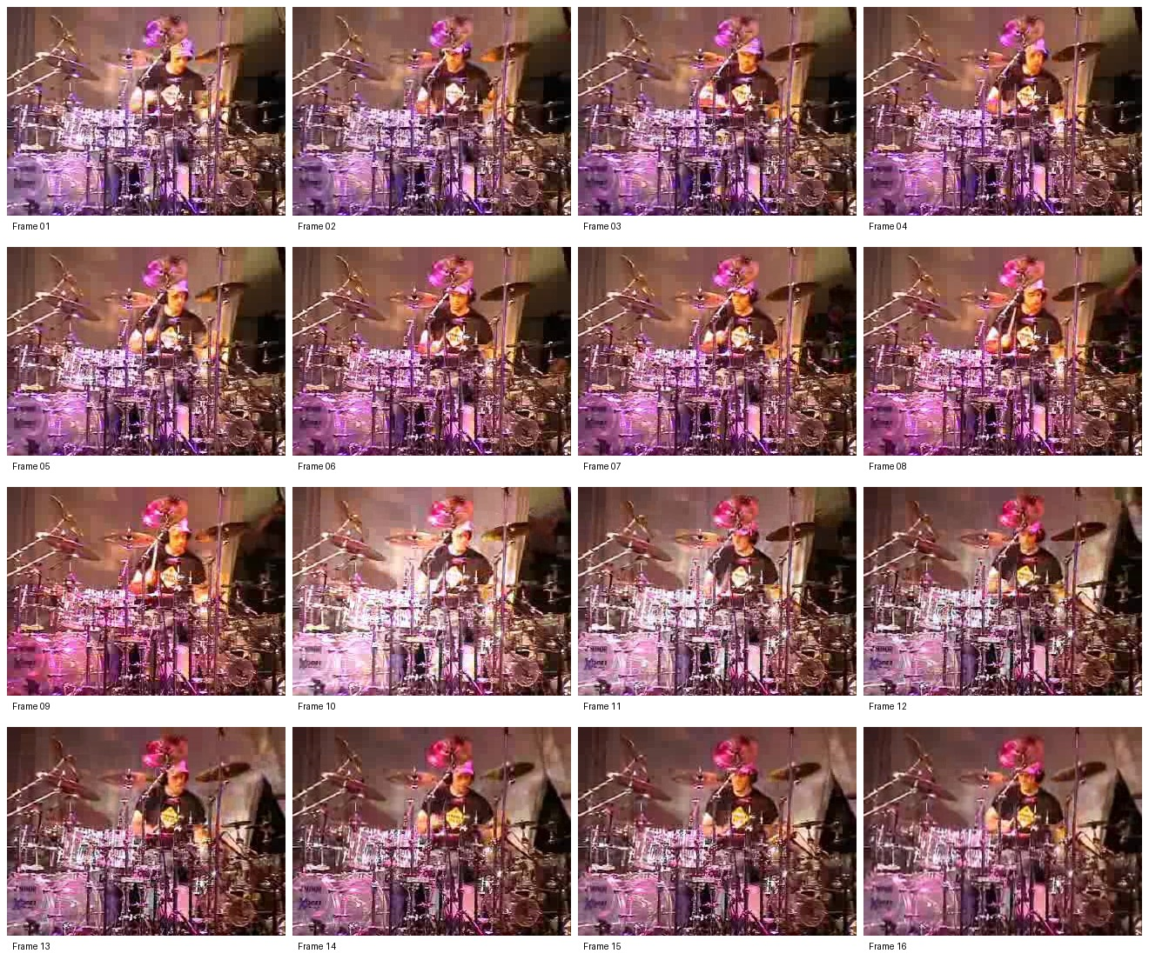




Dataset & Pipeline
UCF101 — 9 selected action classes
UCF101 DATASET
DATASET SPLIT (GROUP-SAFE)
Group-safe split ensures no video-level leakage between train/test
867 train 197 val 197 test 1,261 total videos
Archery
Basketball
Biking
Bowling
Drumming
JavelinThrow
PlayingGuitar
RopeClimbing
Typing
WORKFLOW
Sample: 16 sampled frames — Drumming clip
Video
Frame
Extraction
Dataset
Split
Feature
Extraction
Classification
Semantic Prompt-Guided Human Action Recognition using Vision-Language Fusion
3
Notes:
Introduce the dataset: UCF101, narrowed to 9 visually and semantically distinct action classes for a focused, well-controlled study. Emphasize the group-safe split — videos are split by group/source, not by frame, so no clip leaks between train and test. Then walk the five-stage pipeline left to right: raw video, frame extraction, the dataset split, feature extraction, and finally classification.

Slide 4



Methodology
Dual-branch vision-language fusion architecture
HOW FUSION WORKS
Visual branch: ResNet18 extracts frame-level features, pooled into a video embedding.
ResNet18
Visual Features
Language branch: Sentence-BERT encodes action-class prompts into a semantic embedding space.
Leakage-Safe
Semantic Projection
Prediction
Sentence-BERT
Semantic Space
The projection network maps visual features into semantic space in a leakage-safe manner (no test-time label access), enabling prediction by nearest semantic match.
Semantic Prompt-Guided Human Action Recognition using Vision-Language Fusion
4
Notes:
Explain the two parallel branches: the visual branch (ResNet18 to visual features) and the language branch (Sentence-BERT to semantic space). Both feed into the leakage-safe Semantic Projection Network, which maps visual features into semantic space without any test-time label access, before producing the final prediction. Emphasize the word "leakage-safe" — this is the deployable design, distinct from the Oracle Fusion experiment discussed later.

Slide 5
Experimental Results
Comparison across three experimental configurations
Model | Accuracy | Macro Precision | Macro Recall | Macro F1 | Weighted F1
Video-Only Baseline | 93.40% | 92.89% | 92.84% | 92.77% | 93.41%
Oracle Fusion* | 100.00% | 100.00% | 100.00% | 100.00% | 100.00%
Leakage-Safe Semantic Projection | 87.82% | 87.09% | 87.40% | 86.39% | 87.34%
KEY OBSERVATIONS
Video-Only Baseline: strong, fully deployable at 93.40% accuracy — 197 held-out test videos, 4 of 9 classes at a perfect F1 (Bowling, Drumming, PlayingGuitar, Typing).
Oracle Fusion hits 100% only because the ground-truth label leaked in via the text embedding — confirmed by Fig. 5.2's perfect diagonal, not a real result.
*Oracle Fusion caused by label leakage — not a valid deployable model. (0 of 197 test videos misclassified — a perfect, but meaningless, diagonal.)
Leakage-Safe Semantic Projection: 87.82% honestly, 5.58 pts below the baseline — its errors (e.g. Archery ↔ JavelinThrow) track genuine semantic similarity, not random failure.
Semantic Prompt-Guided Human Action Recognition using Vision-Language Fusion
5
Notes:
Walk the table row by row. Lead with the baseline — 93.40% accuracy is a strong, deployable result on its own. Then address Oracle Fusion directly and without hesitation: 100% accuracy is a red flag, not a win, and it is explicitly caused by label leakage in that experimental setup — call this out proactively so the panel sees you understand the pitfall. Close on the Leakage-Safe Semantic Projection at 87.82% as the honest, deployable fusion result — lower than the leaking oracle, but real.

Slide 6
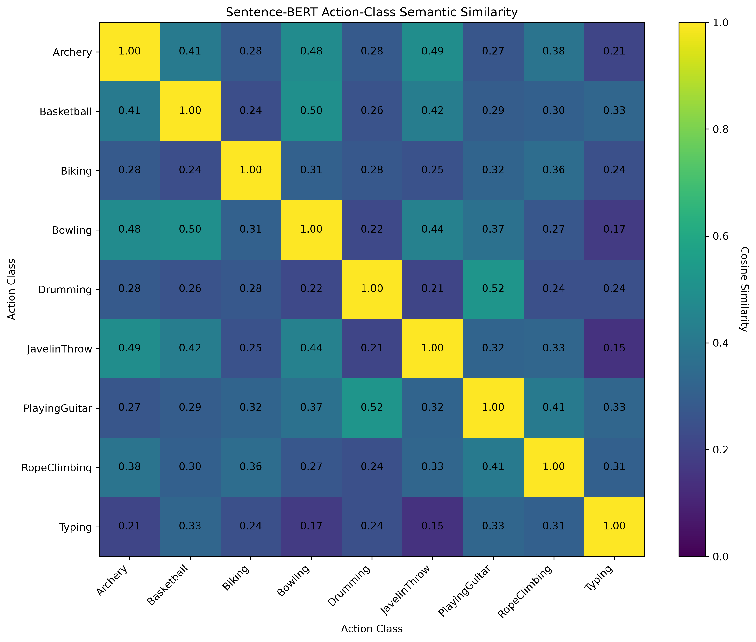
Visual Analysis
Sentence-BERT semantic similarity heatmap
WHAT THIS SHOWS
The heatmap plots pairwise cosine similarity between Sentence-BERT embeddings of each action-class prompt.
Highest similarity (most alike)
Drumming ↔ PlayingGuitar (0.52) · Basketball ↔ Bowling (0.50) · Archery ↔ JavelinThrow (0.49)
Lowest similarity (least alike)
JavelinThrow ↔ Typing (0.15) · Bowling ↔ Typing (0.17) · Archery ↔ Typing (0.21)
Notably, Archery ↔ JavelinThrow — the pair most confused by the visual baseline — is also among the most semantically similar. This is exactly the confusion the leakage-safe projection model reproduces later.
Figure 5.4 — Sentence-BERT Action-Class Semantic Similarity Heatmap
Semantic Prompt-Guided Human Action Recognition using Vision-Language Fusion
6
Notes:
This is the real Sentence-BERT similarity heatmap from Chapter 5 of the report. Explain that each cell is a cosine similarity between two action-class language embeddings. Point to the highest pairs (Drumming-PlayingGuitar at 0.52, both musical/rhythmic activities described in similar language) and the lowest (JavelinThrow-Typing at 0.15, almost no shared vocabulary). Flag the key forward-looking detail: Archery and JavelinThrow are semantically close (0.49) and this exact pair becomes the semantic projection model's biggest error on the next slide — a sign the model is reasoning correctly, not failing randomly.

Slide 7
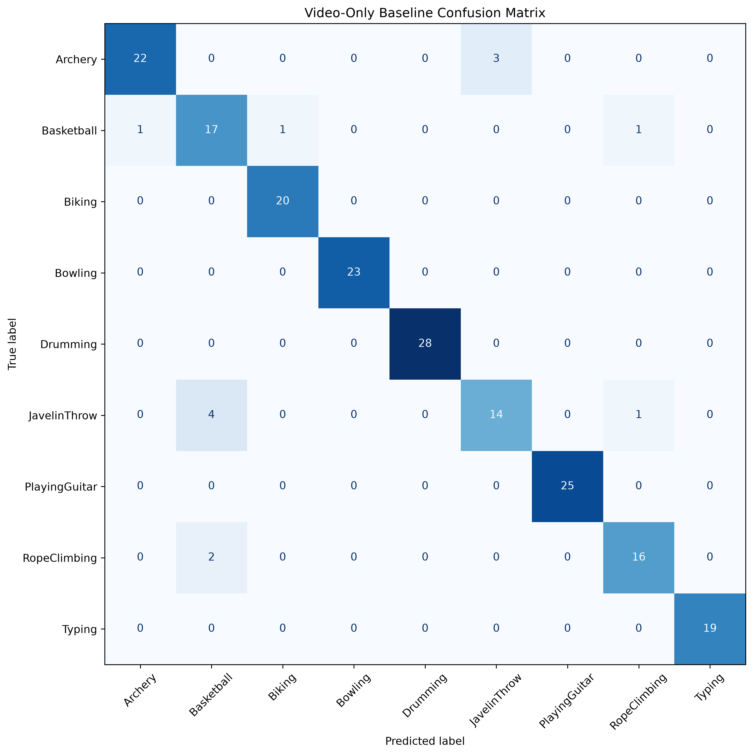
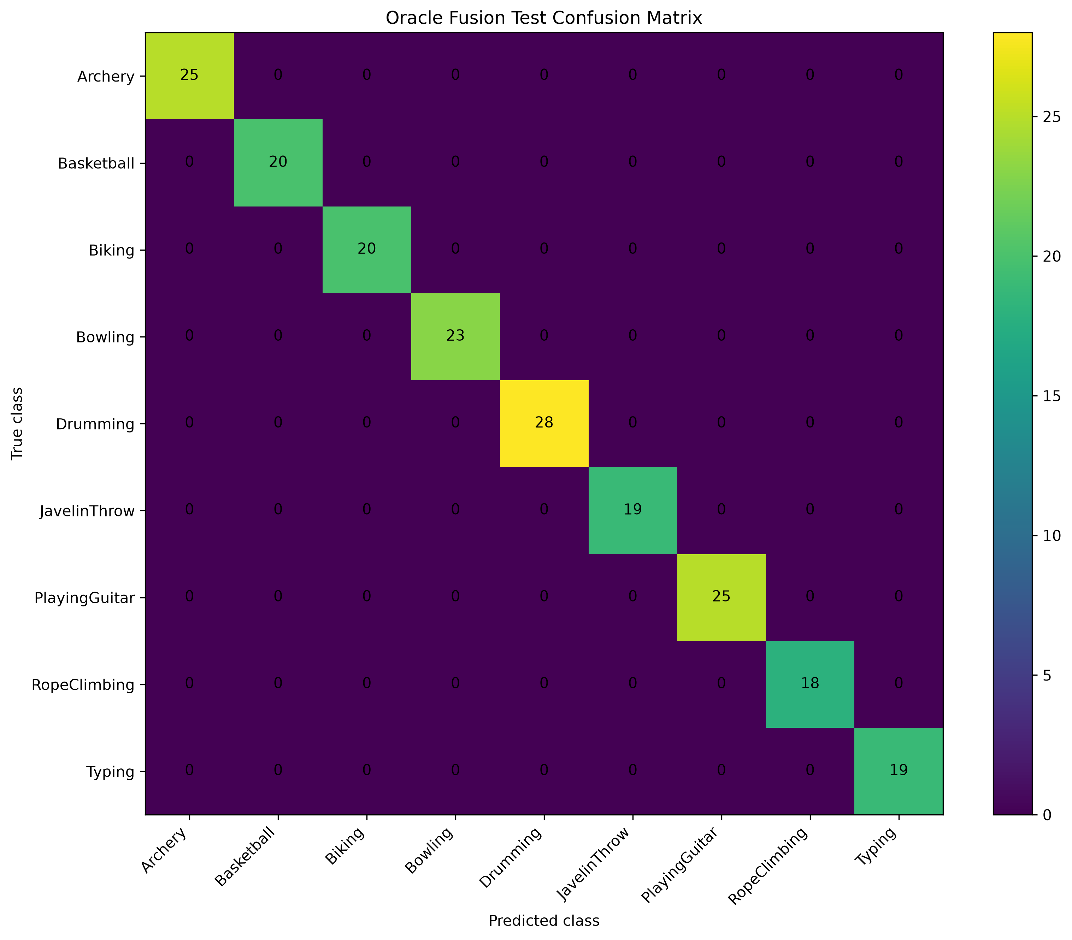
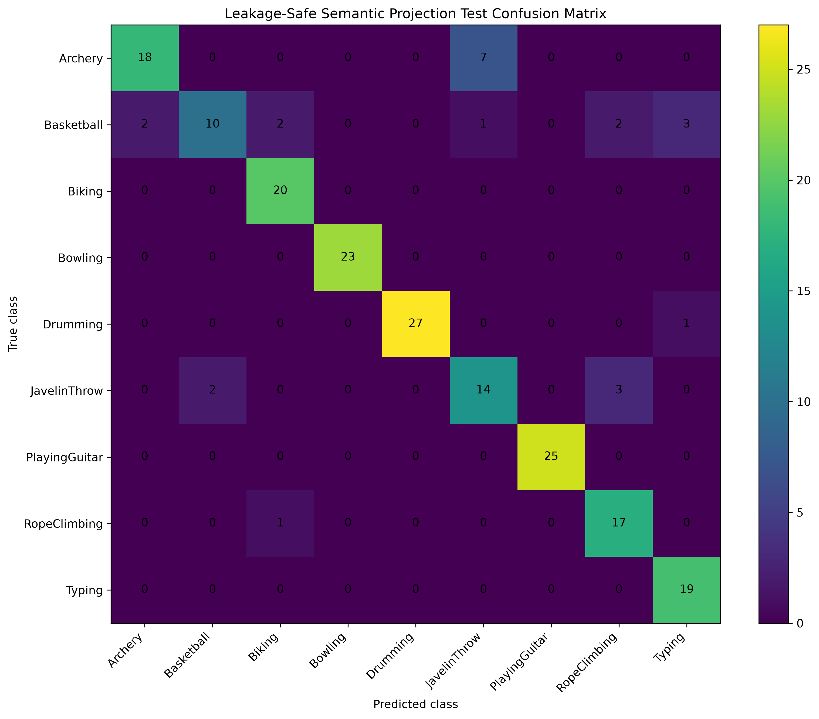
Confusion Matrix Analysis
Three configurations, three very different stories
LEAKAGE
SAFE
Video-Only Baseline
Oracle Fusion
Semantic Projection
Figure 5.1
Figure 5.2
Figure 5.3
Realistic errors: JavelinThrow→Basketball (4), Archery→JavelinThrow (3).
Perfect diagonal — all 197/197 correct — caused by label leakage.
Archery↔JavelinThrow confused 7/25 — tracks semantic similarity.
Oracle Fusion = label leakage. Semantic Projection = leakage-safe, real, deployable performance.
Notes:
Walk left to right through the three real confusion matrices from Chapter 5 of the report. The Video-Only Baseline (Fig. 5.1) shows realistic, mostly-diagonal errors — its biggest confusion is JavelinThrow predicted as Basketball (4 cases). Oracle Fusion (Fig. 5.2) shows a perfect diagonal, all 197 test videos correct — flag this immediately as label leakage, an upper-bound reference, not a real result. The Semantic Projection matrix (Fig. 5.3) shows realistic confusions guided by semantic similarity — most notably Archery confused with JavelinThrow in 7 of 25 cases, mirroring the 0.49 cosine similarity between those two classes seen on the previous slide. Reinforce the takeaway banner at the bottom before moving on.

Slide 8

Deployment
Streamlit demo — end-to-end inference pipeline
Upload Video
Semantic Prompt-Guided Human Action Recognition — Streamlit App
⬆ Upload Video [ Choose File ]
Extract Frames
REPRESENTATIVE EXAMPLE OUTPUT
Predict Action
Prediction: PlayingGuitar
Semantic Similarity: 0.5142 Confidence: Moderate
Confidence
Representative description: "A person holds a guitar and strums the strings."
Top Predictions: 1. PlayingGuitar 2. Drumming 3. RopeClimbing
Explainability Report
Explanation: the projected semantic representation was most similar to the PlayingGuitar class embedding. Reliability note: these are cosine similarities, not calibrated probabilities.
Mock-up of report Section 6.6 — replace with a live screenshot when available.
Semantic Prompt-Guided Human Action Recognition using Vision-Language Fusion
8
Notes:
Walk through the deployed Streamlit workflow: a user uploads a video, frames are extracted automatically, the action is predicted, a confidence score is attached, and an explainability report is generated. The panel on the right reproduces the exact representative example from Section 6.6 of the report: a PlayingGuitar prediction with 0.5142 similarity and Moderate confidence — deliberately lower than the 0.8776 high-confidence Drumming example elsewhere in the report, showing the system communicates uncertainty rather than faking uniform confidence. The runner-up prediction, Drumming, is exactly the pair with the highest cosine similarity (0.52) from the heatmap two slides back — the Top-K output is traceable to real semantic structure, not an opaque ranking. Replace this mock-up with a live screenshot once one is captured.

Slide 9


Challenges & Future Work
CHALLENGES
FUTURE WORK
CPU-only training
CLIP
Video Swin Transformer
Limited dataset size
Temporal Transformers
Semantic projection complexity
Real-time inference
Cloud deployment
Semantic Prompt-Guided Human Action Recognition using Vision-Language Fusion
9
Notes:
Be candid about constraints — CPU-only training, a limited dataset, and the added complexity of the semantic projection step were real challenges. Then pivot forward: name the concrete next steps — CLIP for stronger joint embeddings, Video Swin Transformer and Temporal Transformers for better temporal modeling, and real-time inference with cloud deployment for a production-ready system.

Slide 10



Conclusion
Project Contributions
Lessons Learned
Research Outcome
End-to-end vision-language action recognition pipeline
Perfect scores demand scrutiny, not celebration
A realistic, leakage-safe fusion model at 87.82% accuracy
Rigorous, leakage-aware evaluation methodology
Semantic embeddings add real value beyond pixels
A clear, honest baseline-vs-fusion comparison
Explainable, deployed Streamlit inference demo
Deployment constraints shape architecture choices
A foundation for future temporal & CLIP-based extensions
Thank You
Questions?
Notes:
Summarize the three pillars: what was built, what was learned, and what the honest research outcome is. Reiterate the headline number — an 87.82% accuracy leakage-safe fusion model — as the real, deployable contribution, distinct from the misleading 100% oracle figure. Close warmly, thank the panel, and open the floor for questions.

